Slide 1
Trigonometric functions
Shreyas M
B.Tech in ECE PES University Bangalore

Slide 2
Chapter map
Section | Topic
1 | Introduction
2 | Conventions and units
3 | Recap of Trigonometric functions and their graphs
4 | Sign of trigonometric functions
5 | Values of trigonometric functions of some commonly used angles
6 | Identities and proof
7 | Trigonometric equations
8 | Sine rule and cosine rule

Slide 3
1 Introduction
The word ‘trigonometry’ is derived from the two Greek words ‘trigon’ (triangle) and ‘metron’ (measure) and it means ‘measuring the sides of a triangle’.
Currently, trigonometry is used in many areas such as the science of seismology, designing electric circuits, describing the state of an atom, predicting the heights of tides in the ocean, analyzing a musical tone and in many other areas.

Slide 4
2 Conventions and units
The most important convention is,
The positive x-axis is taken as reference.
Any angle measured clockwise wrt reference is taken as negative.
Any angle measure anti-clockwise wrt reference is taken as positive
Units of angles: There are 2 universal units of angles
Degrees
Radians
Radians measure is the SI unit of Angle

Slide 5
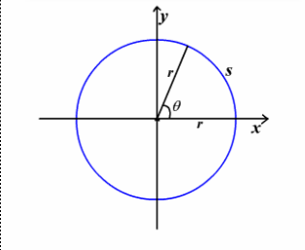
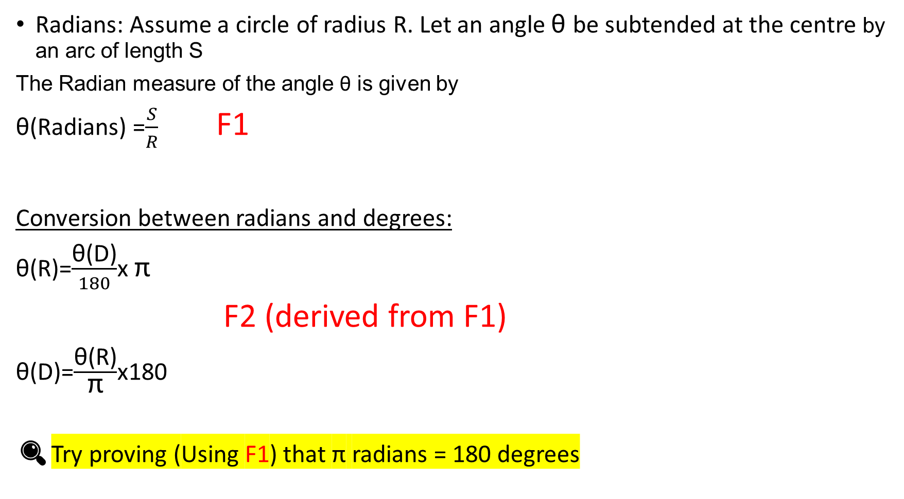
Radians: Assume a circle of radius R. Let an angle θ be subtended at the centre by an arc of length S
The Radian measure of the angle θ is given by
θ(Radians) =$\frac{S}{R}$ F1
Conversion between radians and degrees:
θ(R)=$\frac{\text{θ}\text{(}\text{D}\text{)}}{180}$x π
F2 (derived from F1)
θ(D)=$\frac{\text{θ}\text{(}\text{R}\text{)}}{\text{π}}$x180
🔍Try proving (Using F1) that $\text{π}$ radians = 180 degrees

Slide 6
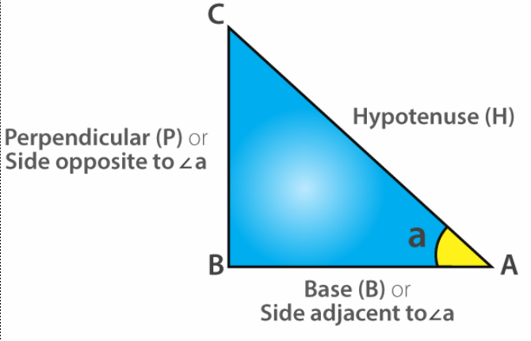
3 Recap of Trigonometric functions
Diagram
θ

Slide 7
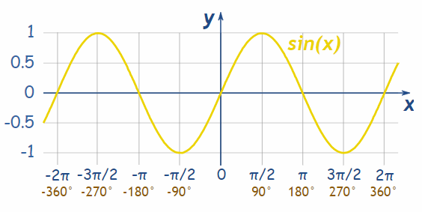
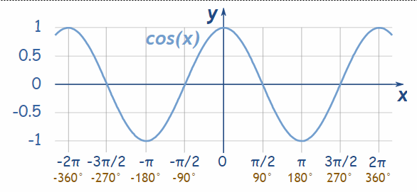


Sine
Cosine
Sin θ = $\frac{O}{H}$ F3
Graph:
Cos θ = $\frac{A}{H}$ F4
Graph:

Slide 8
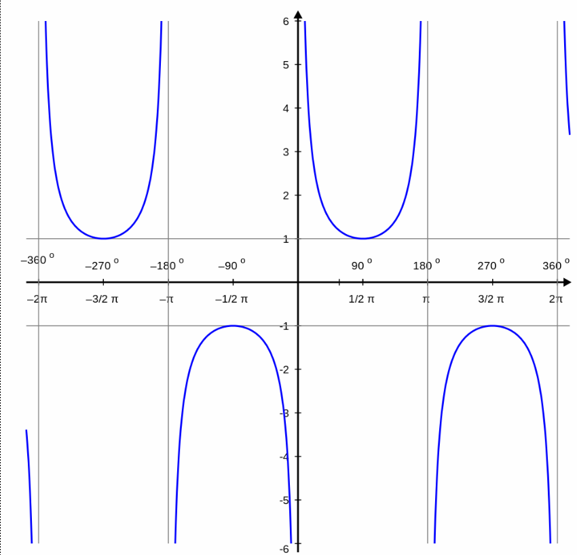
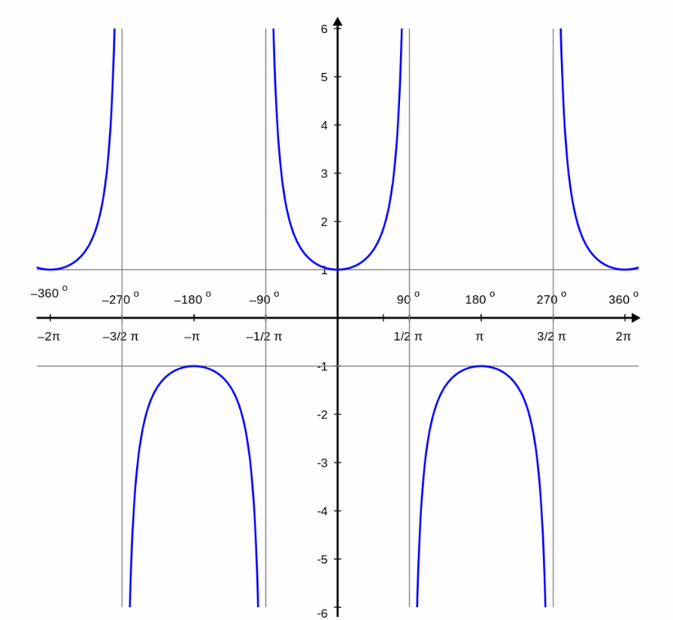


Cosecant
Secant
csc θ = Cosec θ = $\frac{1}{\text{Sin} \text{θ}}$ F5
Graph :
Sc θ = Sec θ = $\frac{1}{\text{Cos} \text{θ}}$ F6
Graph:

Slide 9
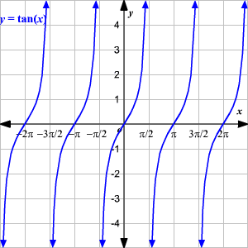
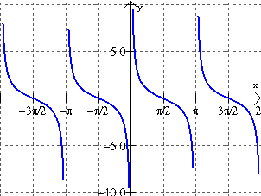


Tangent
Co-Tangent
Tan θ = $\frac{\text{Sin} \text{θ}}{\text{Cos} \text{θ}}$ =$\frac{\text{Sec} \text{θ}}{\text{c}\text{o}\text{s}\text{e}\text{c} \text{θ}}$ F7
Graph:
Cot θ = $\frac{1}{\text{Tan} \text{θ}}$ F8
Graph:

Slide 10
Basic Identity: Sum of squares of T-Ratios
Sin²θ + Cos²θ = 1 ------------------------A
1 + Cot²θ = Csc²θ ------------------------B
1 + Tan²θ = Sc²θ --------------------------C
Csc²θ + Sc²θ = (Csc²θ) X (Sc²θ) --------D
🔍Try proving the above identities Hint: Use Pythagoras theorem for A and derive B and C from A itself. For D, Substitute the ratios from previous slides directly .

Slide 11
4 Sign of trigonometric functions
θ(Deg) | Quadrant | Sin | Cos | Cosec | Sec | Tan | Cot | Pos
(0,90) | I | + | + | + | + | + | + | All
(90,180) | II | + | - | + | - | - | - | Sin & cosec
(180,270) | III | - | - | - | - | + | + | Tan & cot
(270,360) | IV | - | + | - | + | - | - | Cos & sec

Slide 12
Concept of allied angles: Assume that θ<90⁰
The following table shows conversion between the allied angles
x | θ | 90-θ | 90+θ | 180-θ | 180+θ | 270-θ | 270+θ | -θ
Sin x | +Sin θ | +Cos θ | +Cos θ | +Sin θ | -Sin θ | -Cos θ | - Cos θ | -Sin θ
Cos x | +Cos θ | +Sin θ | -Sin θ | -Cos θ | -Cos θ | -Sin θ | +Sin θ | +Cos θ
Cosec x | +Cosec θ | +Sec θ | +Sec θ | +Cosec θ | -Cosec θ | -Sec θ | -Sec θ | -Cosec θ
Sec x | +Sec θ | +Cosecθ | -Cosec θ | +Sec θ | -Sec θ | -Cosecθ | +Cosec θ | +Sec θ
Tan x | +Tan θ | +Cot θ | -Cot θ | -Tan θ | +Tan θ | +Cot θ | -Cot θ | -Tan θ
Cot x | +Cot θ | +Tan θ | -Tan θ | -Cot θ | +Cot θ | +Tan θ | -Tan θ | -Cot θ

Slide 13
In the table, For x=(2n+1)90º +/- θ , we observe the substitution as
Sin ←→Cos
Sec←→Cosec Tan←→Cot
This is the reason that angles of the form x=(n)90º +/- θ are called “Allied” angles if n is odd.
Shortcut to remember the table:
Identify the quadrant and mention the sign accordingly
Identify whether x is allied angle or not. If so, identify the corresponding substitution.
Insert the original angle θ. Evaluation of this gives the final result.
To calculate trigonometric functions of large angles, write the angle in the form (n)90º +/- θ and then apply the above three steps.

Slide 14
Example to demonstrate the shortcut:
Q: Compute Cot(x) i)x= 270-37º ii) 180-37º
Sol:
X is of the form (2n+1)90 – θ where θ=37º
So x is an allied angle. So result is Tan θ
Also 270-θ lies in the 3rd quadrant so the result is Positive as cot and tan are positive in 3rd quadrant
So Cot(270-37º) = + Tan (37º)
ii) X is of the form 180- θ which is not an allied angle. So result remains Cot θ. Also the angle is in 2nd quadrant so the sign will be negative
Hence Cot(180-37º)= -Cot(37º)

Slide 15
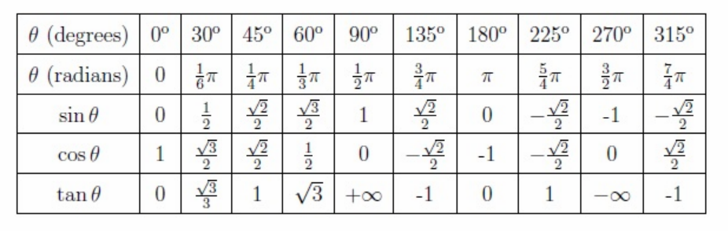
5 Values of trigonometric functions of some commonly used angles

Slide 16
6 Trigonometric Identities and proof
Identities are equations which hold good for any non-trivial values of variables
In Trigonometry, we have the following set of identities
3.6.1 SoA (Sum-of-Angles) ⚠️basis of all derivations and proofs
3.6.2 DoA (Difference-of-Angles)
3.6.3 DTA (Double and Triple Angles)
3.6.4 HA (Half Angles)
3.6.5 PTR (Product of Trigonometric Ratios)
3.6.6 SDTR (Sum and Difference of Trigonometric Ratios)
Note: You might want to refer back to the yellow column on Concept of Allied Angles for DOA

Slide 17
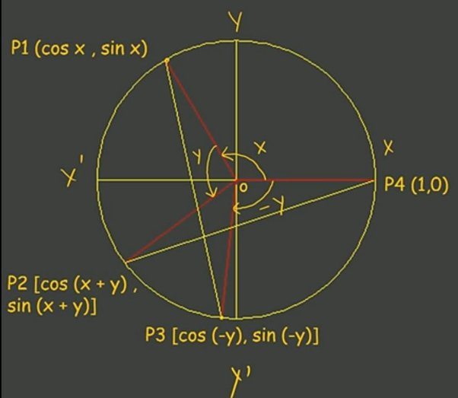
6.(1,2) SoA and DoA Identities
Cos(x + y) ⚠️Derivation 1
Prerequisite : deriving coordinates of P1,P2,P3 and P4 as shown in the diagram
Proof:
Triangle P1OP3 is congruent to P2OP4 by Side-Angle-Side criteria
Therefore
(P1P3 )= (P2P4)
=> (P1P3 )²= (P2P4)²--------------(1)

Slide 18
Applying distance formula for P1P3 and P2P4 we get the equations as follows
LHS(1) =[cos x – cos (– y)]² + [sin x – sin(–y)]²
= (cos x – cos y)² + (sin x + sin y)²
= 2 – 2 (cos x cos y – sin x sin y)
RHS(1) = [1 – cos (x + y)]² + [0 – sin (x + y)]²
= 1 – 2cos (x + y) + cos2 (x + y) + sin2 (x + y)
= 2 – 2 cos (x + y)
Substitute LHS(1) and RHS(1) in (1). With required cancelation, we get
Cos(x + y)= Cos(x) Cos(y) – Sin(x) Sin(y)

Slide 19

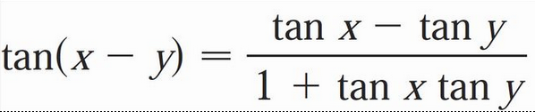
Summary of SoA and DoA
Identity | Identity Tag | Approach
Cos(x + y)= Cos(x) Cos(y) – Sin(x) Sin(y) | SoA 1 | Graphical (as illustrated in previous two slides)
Cos(x - y)= Cos(x) Cos(y) + Sin(x) Sin(y) | DoA 1 | Substitute y → -y in SoA 1
Sin(x + y)= Sin(x) Cos(y) + Cos(x) Sin(y) | SoA 2 | Sin(A)=Cos(90-A) → A=x + y → Sin(x + y)=Cos[(90-x)-y] →Expand using DoA 1 → Substitute Cos(90-x) as Sin(x)
Sin(x - y)= Sin(x) Cos(y) – Cos(x) Sin(y) | DoA 2 | Substitute y→ -y
 | SoA 3 | SoA 2 / SoA 1 → Divide numerator and denominator by Cos(x) Cos(y)
 | DoA 3 | DoA 2 / DoA 1 → Divide numerator and denominator by Cos(x) Cos(y)

Slide 20
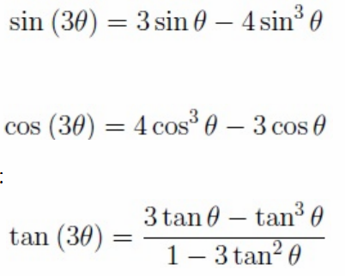

6.3 DTA Identities
Double Angles (Substitute y → x in all SoAs) (DA 1,2,3)
Sin(2x)= 2sin(x)cos(x)
Cos(2x)=Cos²(x)-Sin²(x)
Tan2x=$\frac{2Tanx}{1−Tan2x}$
Triple Angle (Substitute y → 2x in all SoAs) (TA 1,2,3)

Slide 21
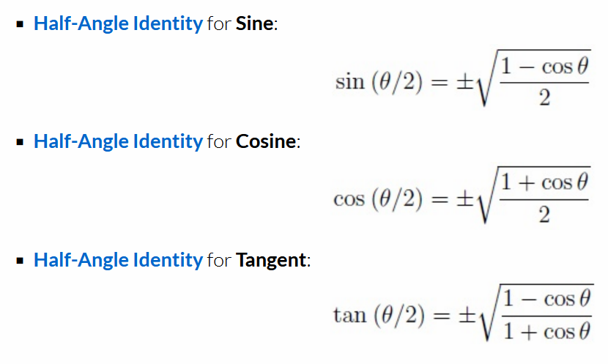
6.4 Half Angle Identities
Derivation not required

Slide 22
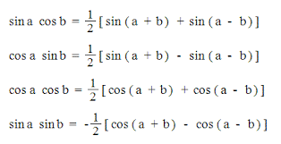
6.4 Product of Trigonometric Ratios
These can be derived by applying SoA/DoA to the right hand side of the equations
PTR 1
PTR 2
PTR 3
PTR 4

Slide 23
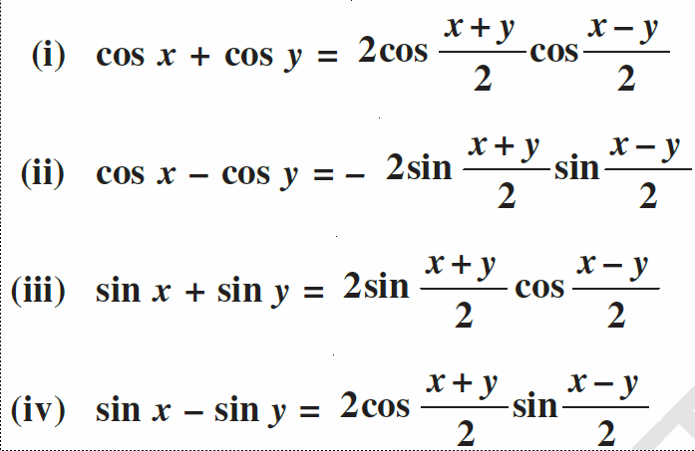
6.5 Sum and Difference of Trigonometric Ratios (STR, DTR)
These can be derived by applying SoA/DoA to the right hand side of the equations
STR 1
DTR 1
STR 2
DTR 2

Slide 24
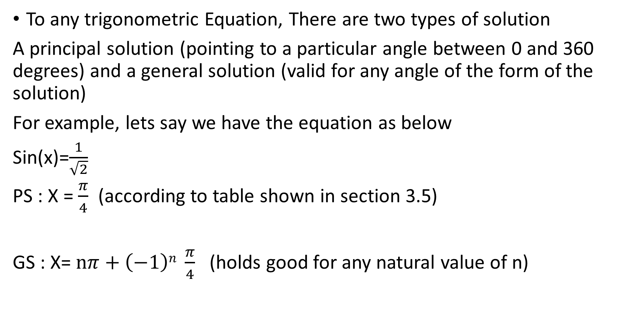
7 Trigonometric Equations
To any trigonometric Equation, There are two types of solution
A principal solution (pointing to a particular angle between 0 and 360 degrees) and a general solution (valid for any angle of the form of the solution)
For example, lets say we have the equation as below
Sin(x)=$\frac{1}{\sqrt{2}}$
PS : X = $\frac{π}{4}$ (according to table shown in section 3.5)
GS : X= $nπ+\left(−1\right)n \frac{π}{4}$ (holds good for any natural value of n)

Slide 25
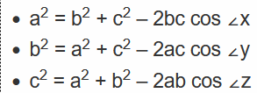
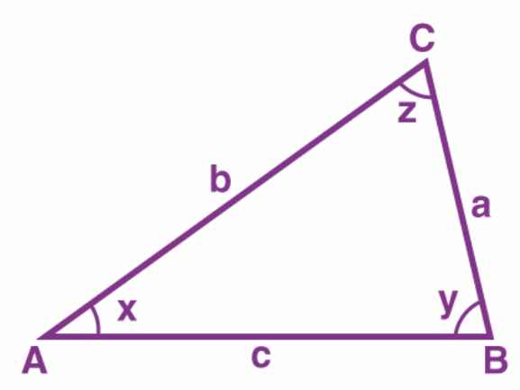
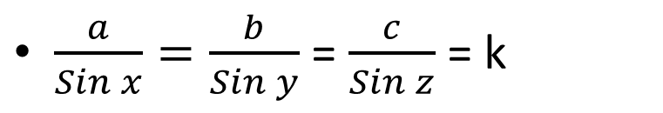
9 Sine rule and cosine rule
Sin Rule
Cosine Rule
$\frac{a}{Sin x}=\frac{b}{Sin y}$ = $\frac{c}{Sin z}$ = k

Slide 26
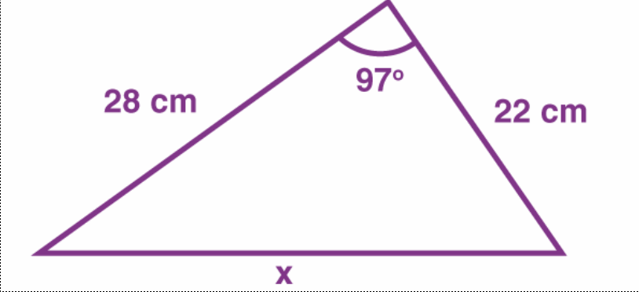

Applications of Sine and Cosine rule
Given any 2 sides and the angle between them, all the other sides can be calculated and thus whole triangle can be constructed.
Q. Find x and all the two base angles y,z angles
Hint : Cosine rule for x and Sine rule for the base angles
Y Z

Slide 27
Thank you
Shreyas M
B.Tech in ECE PES University Bangalore

